Slide 1

Project Management

Slide 2
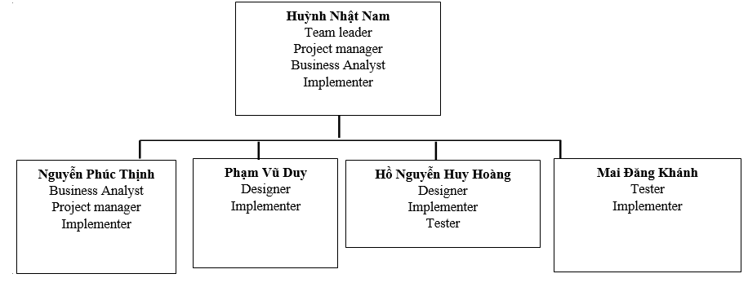
Team structure

Slide 3
responsibilities
1. Huỳnh Nhật Nam
- Write test plan, assigning tasks
- Monitor and control the project
- Write use case specification

Slide 4
responsibilities
2. Nguyễn Phúc Thịnh
Document requirements (vision document, use-case, etc…)
Communicate with team member about the requirements
Coordinate to review requirements

Slide 5
responsibilities
3. Phạm Vũ Duy
Design the system (Component, classes, databases,…)
Write Software Architecture Document
Design user interface

Slide 6
responsibilities
4. Hồ Nguyễn Huy Hoàng
Design the system (Component, classes, databases,…)
Write Software Architecture Document
Perform system test

Slide 7
responsibilities
5. Mai Đăng Khánh
Write test plan and test cases
Perform system test

Slide 8
Implementation
Huỳnh Nhật Nam: account, cart, checkout
Nguyễn Phúc Thịnh: browse product, sort product
Phạm Vũ Duy: comment, search product
Hồ Nguyễn Huy Hoàng: add product, edit product
Mai Đăng Khánh: view product detail

